Slide 1
Work-case 4
Performed by student
group RPZ-13a
Kateryna Hranat

Slide 2

Concepts of "package" and "repository"
Package: In the context of software, a package is an archive that contains an executable file of the program, libraries, configuration files, and other resources necessary for the proper functioning of the program or library. Packages are usually compressed for space efficiency and convenient distribution.
Repository: It is a centralized storage of software packages that contains packages that can be installed, updated, and removed. A repository typically includes versions of programs and their dependencies that have been checked for compatibility and security.

Slide 3
Overview of existing package managers in Linux

Slide 4
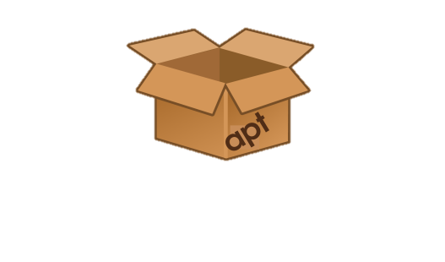
APT (Advanced Package Tool)
Used in Debian, Ubuntu, and other Debian-based distributions. It allows installing, updating, and removing packages from official repositories.

Slide 5

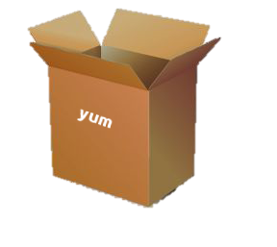
YUM (Yellowdog Updater, Modified) / DNF (Dandified YUM)
Used in Fedora, CentOS, and other Red Hat-based distributions. Similar to APT, it allows managing packages from official repositories.

Slide 6
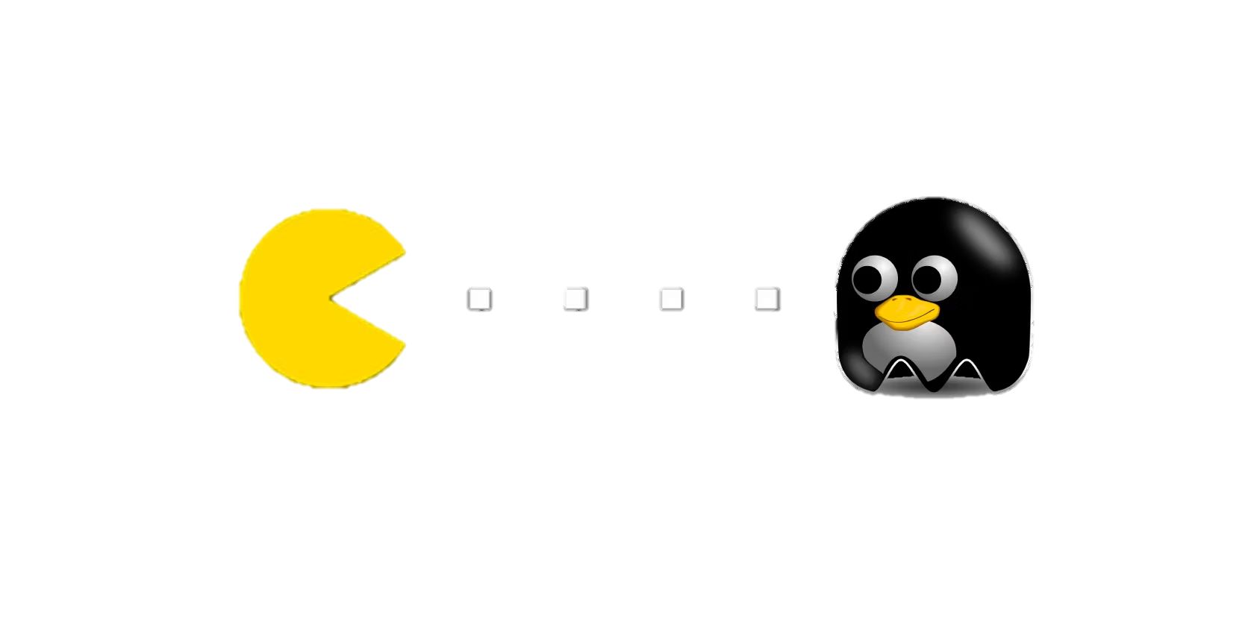
Pacman
Used in Arch Linux and its derivatives. A simple and fast package manager that manages packages from official repositories.

Slide 7

ZYpp (ZENworks Package Management)
Used in openSUSE and SUSE Linux Enterprise. It allows managing packages from official repositories as well as from third-party sources.

Slide 8
Package manager in my Linux distribution:
Package manager in my Linux distribution is the Ubuntu distribution, the primary package manager in it is APT. Searching, downloading, and installing packages:
• Search: `sudo apt search <package_name>`
• Installation: `sudo apt install <package_name>`
Viewing information about installed and available packages:
Information about installed packages: `dpkg -1`
Information about available packages: `apt list`
Removing packages:
`sudo apt remove <package_name>`
Updating the package manager:
Updating the package list: `sudo apt update`
Updating installed packages: `sudo apt upgrade`
Updating all packages: `sudo apt full-upgrade` (or `sudo apt dist-upgrade`)

Slide 9
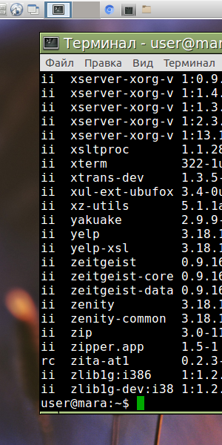
Installing new media player
Installing new media player and programming environment via package manager in the terminal on Ubuntu, if you don't have certain ones pre-installed, you can execute the following commands:
Media player: As an example, let's install VLC Media Player:
“sudo apt update
sudo apt install vlc”
Programming language environment: For instance, let's install Python and its environment
“sudo apt update
sudo apt install python3”

Slide 10
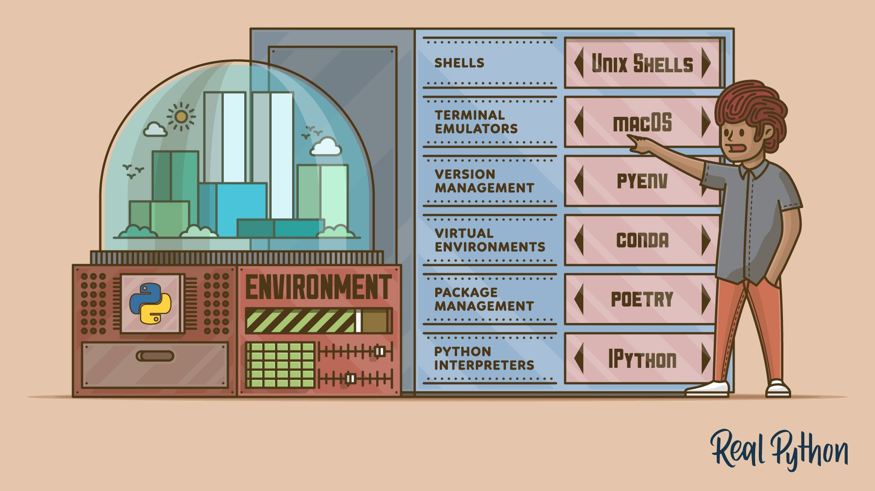
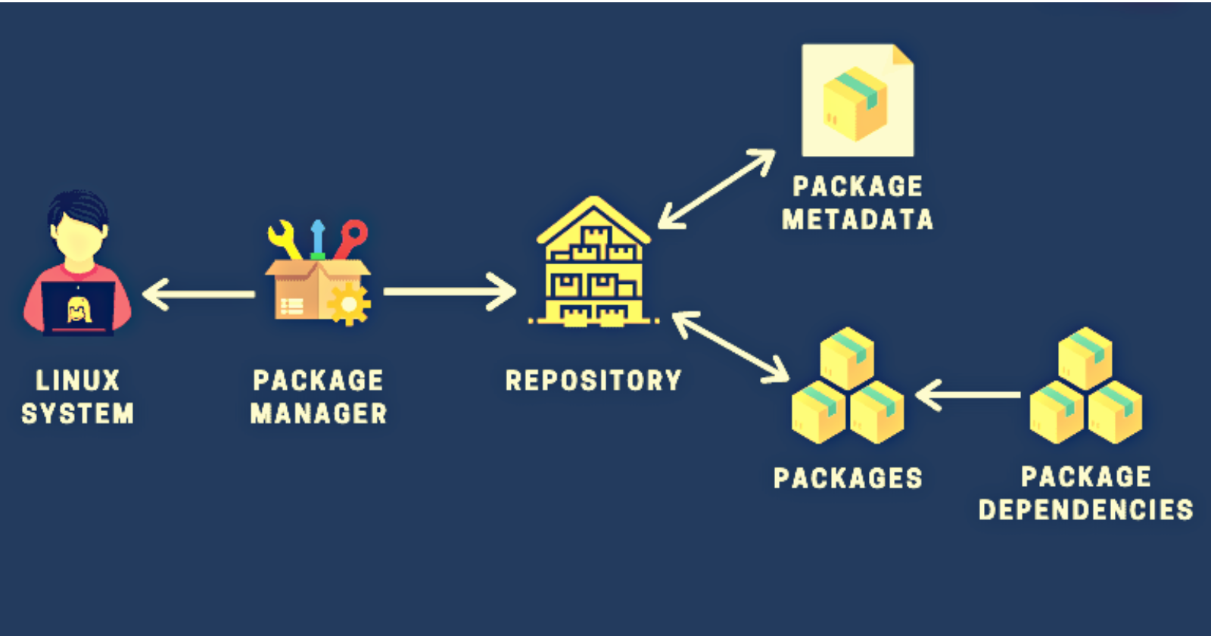
Installing new applications through app stores and package managers in the graphical environment:
App store: Most Linux distributions come with graphical app stores, such as "Ubuntu Software" in Ubuntu, "GNOME Software" in GNOME, "Discover" in KDE, etc. To install applications through the app store, you can open the store, find the desired application using search, and click the "Install" button.
Package manager in the graphical environment: Some distributions also provide graphical interfaces for package managers, such as "Synaptic Package Manager." They offer more advanced capabilities compared to app stores, such as installing and removing packages, managing dependencies, etc.

Slide 11
For example, to install VLC Media Player through "Ubuntu Software," you can open "Ubuntu Software," find VLC using search, and click the "Install" button. To install via the package manager in the graphical environment, you can open "Synaptic Package Manager," find VLC using search, select it, and choose the "Install" option.
Both approaches - through app stores and package managers in the graphical environment - provide a convenient way to install applications on Linux.

Slide 12

Conclusions:
During the execution of this Work Case, the process of installing programs through the package manager in the terminal on Ubuntu was discussed. Examples of installing VLC Media Player and the Python programming environment were used for this purpose. Additionally, the possibility of installing programs through graphical app stores and package managers in the graphical environment was described. The overall conclusion is that installing programs on Linux can be easily and conveniently done both through the terminal and through the graphical interface, allowing users to choose the installation method that best suits their needs and preferences.
Author – Kateryna Hranat

Slide 13
Thank you for attention!

